Slide 1
Creating a Web Report
Notes:
Schedule: Timing Topic
<xx> minutes Lecture
<xx> minutes Practice
<xx> minutes Total

Slide 2
Objectives
After completing this lesson, you should be able to do the following:
  Identify the options for designing a Web page
  Create a simple Web report using the Report Wizard
  Invoke the Web Source view of the Report Editor
  Describe the elements of the Web source code
  Preview a Web report
Notes:
Lesson Aim
<Enter lesson aim here.>

Slide 3

What Is JSP Technology?
  Dynamic scripting capability for Web pages
  Server-side technology
  Enables the separation of dynamic and static content in a Web page

Slide 4
JSP Advantages
  Separation of dynamic and static content
  Support for scripting and tags
  Reuse of components and tags
  Portable, powerful, and easy to use
  Accepted industry standard for building dynamic Web pages

Slide 5
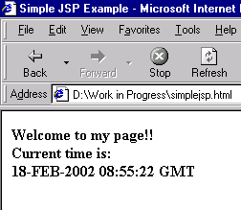
Simple JSP Example
<HTML>
<HEAD><TITLE>Simple JSP Example</TITLE></HEAD>
<BODY>
Welcome to my page!!
Current time is :
<%= new java.util.Date() %>
</BODY>
</HTML>

Slide 6
Building a Web Report
Two Options:
  Open an existing HTML page in Reports Builder
  Use one of the predefined HTML templates shipped with Oracle9i Reports Developer

Slide 7
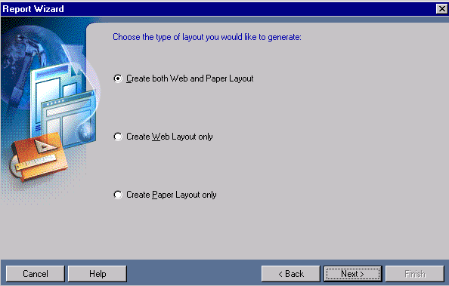
Using the Report Wizard

Slide 8
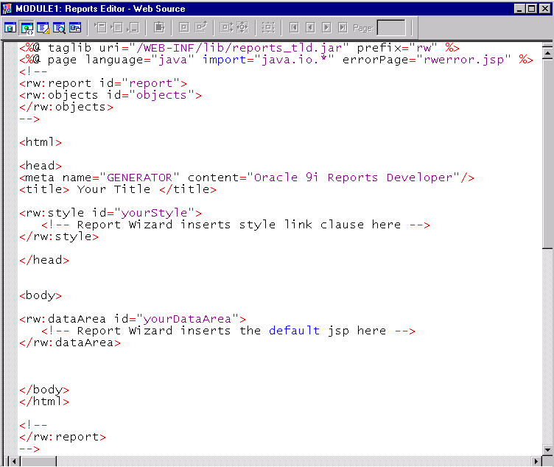
Report Editor: Web Source View
Reports JSP
Custom Tag
Library
Start of report
HTML template
information
Data model
information
End of report

Slide 9
JSP Tags
  Standard JSP Tags
    taglib
    page
  Reports Custom JSP Tags
    rw:report
    rw:objects
    rw:foreach
    rw:field
    rw:include

Slide 10
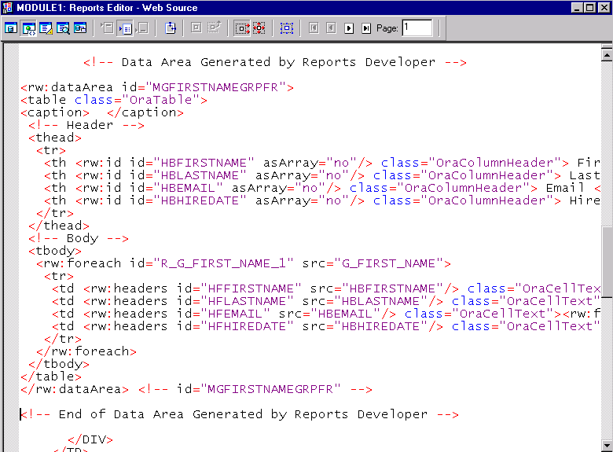
Web Source Example

Slide 11
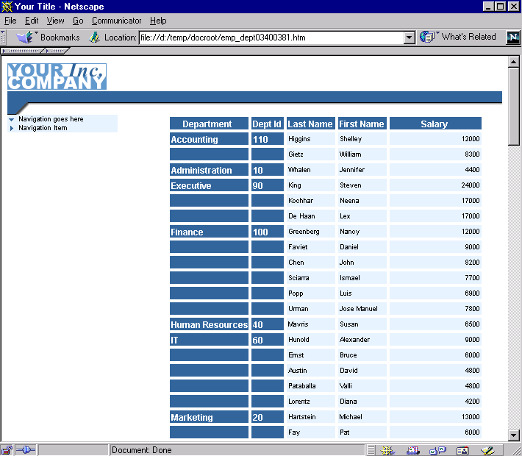
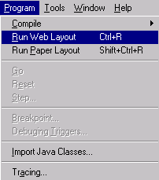
Generating Output

Slide 12
Summary
In this lesson, you should have learned how to:
  Create a Web report using the Report Wizard and a predefined HTML template
  Identify and describe standard and Reports custom JSP tags
  Use the Run Web Layout feature to test Web deployment

Slide 13
Practice 7 Overview
  Creating Web reports using the Report Wizard
  Examining the Web source code
  Modifying a Web report using the Report Wizard

